Slide 1
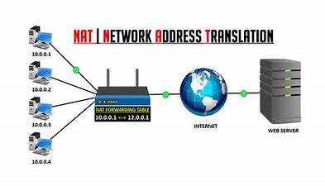
CNS PROJECT REVIEW GROUP – 15 TITLE :- Network Address Translation (NAT)

Slide 2
GROUP MEMBERS
NAVADEEP – 2010030313
SIDDHARTH – 2010030475
VIPUL REDDY – 2010030502
MANOJ PERAVALLI - 2010030503

Slide 3
ABSTRACT
Today, network address translators, or NATs, are everywhere. Their adoption was promoted by the continued growth of the Internet, which places an ever-increasing demand not only on IP address space but also on other functional requirements. This is to presents a personal perspective on the history of NATs, their pros and cons in a retrospective light, and the lessons we can learn from the NAT experience.

Slide 4
INTRODUCTION
NAT is the process of reassigning the single IP address into a further one by altering the network address data in the IP header while they are traveling through a network towards the destination node.
NAT works on a router or gateway and interconnects two networks with each other by translating the private addresses into the registered addresses before the data being transmitted to another network.
NAT is having the potential to broadcast only one IP address to the public network on behalf of the entire internal network. This provisions the feature of security by efficiently hiding the overall IP address of the private network behind that solo address.

Slide 5
SOFTWARE REQUIREMENTS
HARDWARE REQUIREMENTS
OS : Windows
Tools : Cisco lOS , Web server
Processor: Intel Core 5
System-type: 32-bit OS
Version: 20H2
Edition: Windows 10
WI-FI Router

Slide 6
LITERACTURE SURVEY
Network Protocols Handbook (2 ed.). Javvin Technologies Inc. 2005. p. 27. ISBN 9780974094526. Retrieved 2014-09-16.
Network Protocols Handbook is designed to help IT and networking professionals to nevigate the network communication protocol territories smoothly. Highlights of the book are: Fully explains and illustrates all commonly used network communication protocols, including TCP/IP, WAN, LAN technologies Covers the latest and emerging technologies such as VOIP, SAN, MAN, VPN/Security, WLAN, VLAN and more Addresses vendor specific technologies: Cisco, IBM, Novell, Sun, HP, Microsoft, Apple, etc.
"Configure Server Load Balancing Using Dynamic NAT". June 2018.
Users that access the local server from outside Internet will access the server using a single URL or IP address, however the NAT device is used to load share the user traffic to multiple identical servers with mirrored content.
"K7820: Overview of SNAT features". AskF5. August 28, 2007. Retrieved February 24, 2019.
A Secure Network Address Translation (SNAT) is an object that maps the source client IP address in a request to a translation address defined on the BIG-IP device. When the BIG-IP system receives a request from a client, and if the client IP address in the request is defined in the origin address list for the SNAT, the BIG-IP system translates the source IP address of the incoming packet to the SNAT address.

Slide 7
NAT Methods NAT takes several forms: i) Static NAT (SNAT) ii) Dynamic NAT (DNAT) iii) Port Address Translation (PAT) Let's look at each of these methods separately.

Slide 8
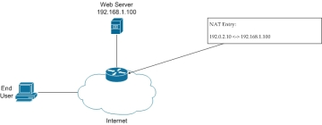
Static NAT When using SNAT, a single internal (private) address is mapped to a single external (public) address. This type of implementation is most commonly used when a device inside a privately addressed network must be accessible directly from the Internet.

Slide 9
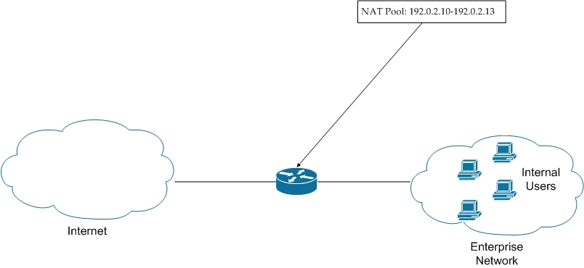
Dynamic NAT DNAT provides the functionality of SNAT, but with a pool of addresses that are not device-specific

Slide 10
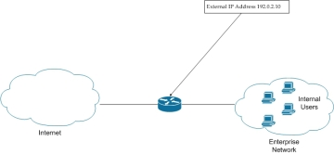
Port Address Translation PAT offers a method that can be configured statically or dynamically, but in either case it provides a solution to the address exhaustion problem, by allowing multiple devices to use the same external IP address at the same time. This technique works primarily by taking advantage of Layer 4 TCP and UDP port numbers. The source port number is altered and mapped for each outgoing connection; in this way, any returning traffic to that specific port can be mapped to the correct internal address

Slide 11
Summary Like many other Internet services, NAT is used every day by millions of people, and most of them have no idea they're using it. The Internet would be radically different today if the number of available addresses were exhausted without NAT being implemented. Modern NAT is utilized in much the same way that it was 15–20 years ago, but it has evolved into being used for both IPv4 and IPv6 addressing. Versions of NAT have been created that translate from an IPv4 address into an IPv6 address and vice versa; this tool will be used more as IPv4 addresses are slowly phased out and IPv6 addresses are phased in

Slide 12
SCOPE
A public address is a global IP address. It is accessible to other devices on the internet, outside of a given LAN network. A private address is an IP address assigned to a specific network device. It is accessible only to other devices within the same local network.
Devices with private IP addresses can send requests for data. However, if the source IP address remains private, the receiving server can’t tell where to return the data back to.
This is where network address translation comes in. When sending data requests to an external network, a NAT router or NAT firewall is able to convert the device’s private IP address into the network’s public IP address. This ensures that the data is sent to the right place.

Slide 13
Conclusion Network address translation, when used appropriately, is a valuable resource to managed service providers. It can be used to direct traffic as needed and helps to conserve IP addresses in the public space. While there are different types of network address translation based on need, there are tools to use and security considerations to be made for each case. Now that we’ve made network address translation easier to understand, this is a great time to do a little research to see how it can be better used to help your managed service provider and its clients today.

Slide 14
References:- [1] Ishikawa, Y.; Yamai, N.; Okayama, K.; Nakamura, M.; , "An Identification Method of PCs behind NAT Router with Proxy Authentication on HTTP Communication," Applications and the Internet (SAINT), 2011 IEEE/IPSJ 11th International Symposium on , vol., no., pp.445-450, 18-21 July 2011. [2] G. Maier, F. Schneider, and A. Feldmann. NAT Usage in Residential Broadband Networks. Proceedings of the 12th International Conference on Passive and Active Network Measurement (PAM 2011), Atlanta, Georgia, March 2011.

Slide 15
THANK YOU

